Slide 1



National Gala Round
Team: Phantom10
presenting
EasyGrowth

Slide 2
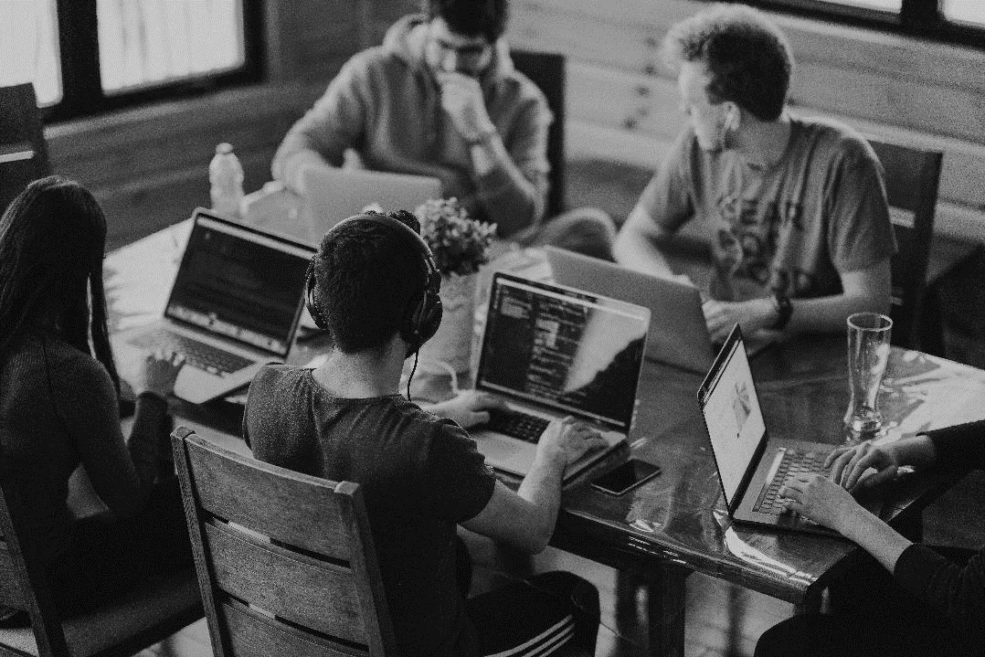


Target Problem
Nowadays many people specially our young generation spend a lot of unproductive hours on different places, platforms including social media. Some want to maintain their good and bad habits, productivity, lifestyle, fitness, but anyhow cannot maintain consistency.
Easy Growth

Slide 3
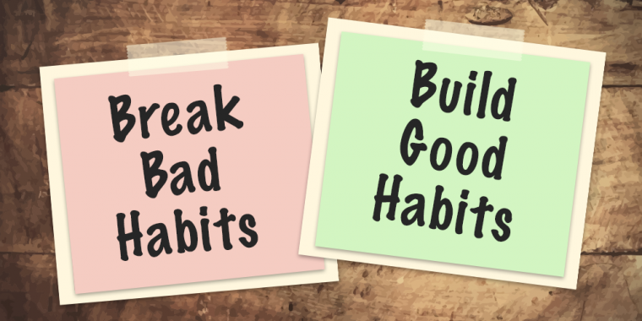
The Solution
If they can maintain these in a suitable way it would help them stay on track.
To build an application to help people improve productivity & good habits that are important keys for all classes of people.
In this application, User can create their own habits and join community.
The application will help the user to maintain good habits for a healthy lifestyle through some interesting features
Easy Growth

Slide 4

Our Uniqueness
In this application, User can create their own habits as per their wish.
There will be a strong community network; User can make friends, write blogs, share their experience or ask for help.
There will be a ranking board for individual habit through which user can see the ranking of himself as well as his friends.
Easy Growth

Slide 5

Market Size
This product is a universal platform as people of all ages and professions can use it.
Initially, our target group is young generation aged between 15 to 40.
Total population of Bangladesh is 166.3 million among them 83.15 million are aged between 15-40. Among them 71.5 million are smartphone users and 51.48 million have internet access. If we can reach 5 million of them, it will be huge. So, hopefully the market size will be large.
Easy Growth

Slide 6

Our Progress
Some features have been implemented, others will be implemented soon.
Easy Growth

Slide 7
Use case of bdapps API
We'll make use of the SMS send, receive, and report service api.
To inquire balance and perform direct debit, we will utilise the CAAS api.
For managing the user subscription process, user base size, user subscription status, and notifying users, we will utilise the subscription api.
The OTP api's otp request and OTP verify services will be used.
Easy Growth

Slide 8

Marketing Plan
Our target is to reach about 10 million people.
Initially we’ll offer all the features for free of cost. After reaching 5k downloads, we’ll offer 1 month free trial and later make premium activation for some attractive features (Graphical reports, exercise tracking etc.).
Ads will be shown in our app by which we can generate some revenue as well.
One can refer others to download the app. For each download by the invitation link, he will get 50 bytecoins. 100 bytecoins = 10 tk.
Easy Growth
]

Slide 9

Targets and Plan of action (1st year)
Within 1st year, we’ll try to establish and Reach our Target market size (reaching each 10k downloads).
As it’s a startup, so initially we’ll offer all the features for free of cost and after certain amount of downloads we’ll make some features premium and try to increase the financial growth gradually.
We’ll add new features and improve our app as per our users’ review.
Easy Growth

Slide 10

Future Plan and Scope
Our application is not only limited to this geographical boundaries, it can be used globally.
So, we’ll try to improve our app to be useful for the people worldwide.
We will update our app version with new features and based on user experience.
Easy Growth
]

Slide 11






Technology Stack
ANDROID CLIENT :
USER AUTHENTICATION :
DATABASE :
VERSION CONTROL :
COLLABORATION:

Slide 12

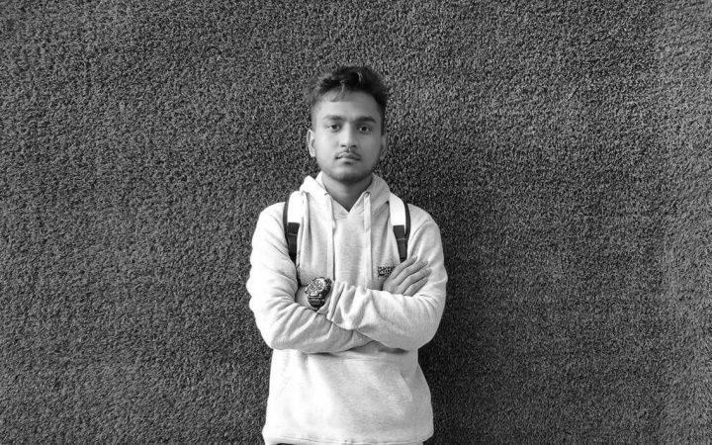

Meet the Team
Mizbah Uddin Junaed
Developement
CSE, SUST
Shanur Milon Showrov
Developement
CSE, SUST
Tithi Saha
Case Study and Research
CSE, SUST
Easy Growth

Slide 13
Open For Questions
Easy Growth

